Slide 1
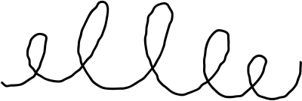


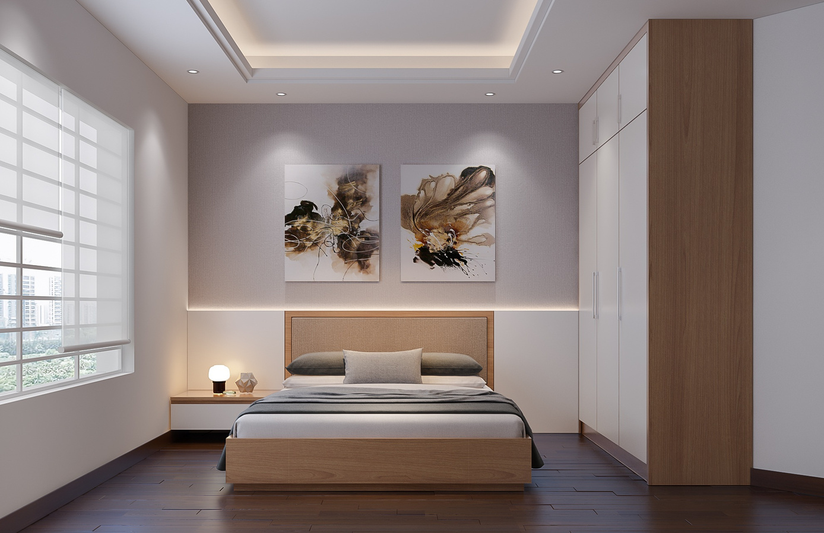

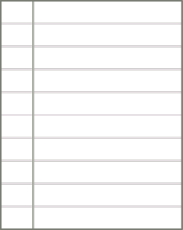

ModifAI
Project Update 2
Overview of progress and future plans for our AI-powered interior decor app

Slide 2






Team Introduction for ModifAI Project Update 2
Akram Hossain Apu Khan – 2231090642
Mehedi Hasan Dip – 2232167042
Together, we are transforming interior decor through AI technology.
Hacibull Hashan Tosher – 2111626642

Slide 3
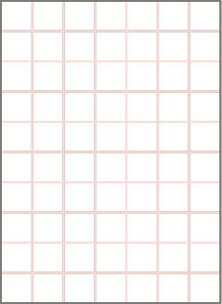

ModifAI Update 2 Overview
Key milestones and progress in our AI-powered interior decor app development journey
Achievements
Current Plans
Conclusion and Next Steps
We have made significant progress with a successful AI connection, implemented UI tweaks, and enhanced our chatbot's ability to reply to messages.
Our next steps include updating the AI, enabling it to respond to images, and adding new features to the profile page for enhanced user experience.
Moving forward, we are committed to refining our app and ensuring it meets user needs effectively as we continue to innovate.

Slide 4
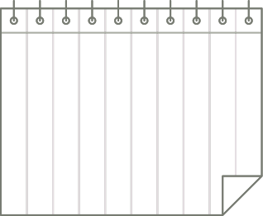
ModifAI Project Update 2
Successful AI Connection
UI Tweaks
Chatbot Replies
Future Enhancements
Our team has focused on improving the user interface, making it more intuitive and engaging. The design changes aim to facilitate smoother navigation and enhance user satisfaction with the app.
The chatbot functionality has been successfully implemented. It now efficiently replies to user messages, providing instant support and helping users with their queries about interior decor choices and app features.
We have achieved a robust AI integration that enhances user experience. The AI now provides more accurate recommendations, learning from user preferences effectively to create personalized interior decor suggestions.
Looking ahead, we plan to update the AI capabilities further, allowing it to respond to images and analyze user-uploaded photos for more tailored suggestions, along with adding new features to the profile page.

Slide 5


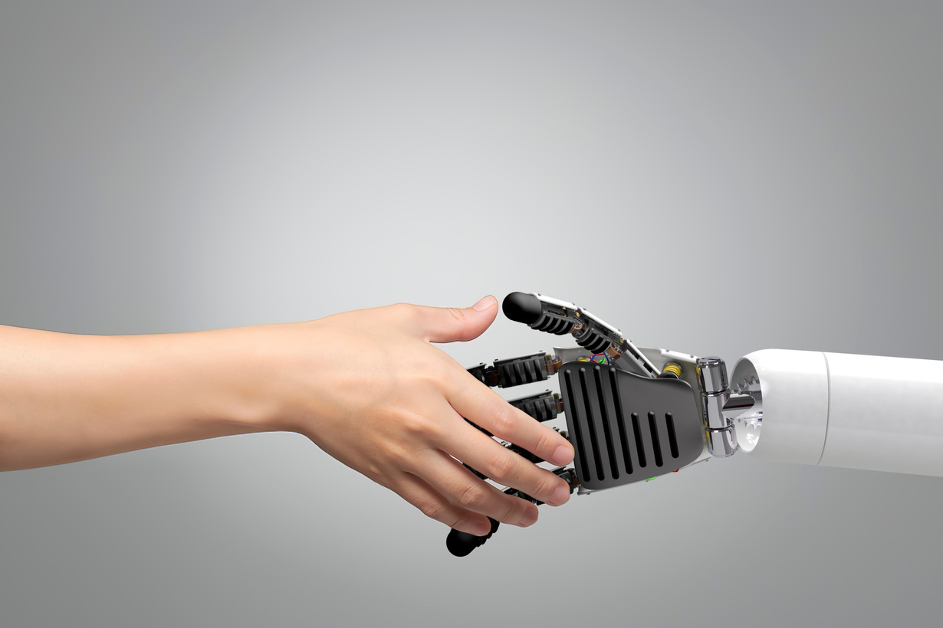

Current Plans for ModifAI
Our primary goal is to update the AI capabilities, enhancing its responsiveness and efficiency.
We aim to enable the AI to process and respond to images, making interactions more intuitive.
Additionally, we will be adding features to the profile page, ensuring users have a seamless and personalized experience.
These enhancements will significantly improve user engagement and satisfaction.

Slide 6

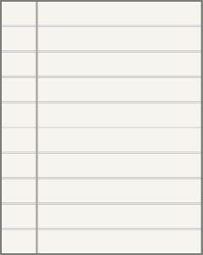

Next Steps for ModifAI
As we move forward, our team is focused on updating the AI to enhance user interactions.
We aim to enable the AI to respond to images, making the app more intuitive and user-friendly.
Additionally, we will be adding features to the profile page, ensuring a richer user experience.
These improvements will help us stay competitive in the interior decor market and meet user needs effectively.

